Slide 1
CUSTOMER CHURN ANALYSIS
Telco Customer Churn Dataset — Business Analytics Presentation
Prepared by Stéphanie HOUNKPATI
AnalystLab Africa Consulting — Week 1

Slide 2
The Business Problem
In a Telecom market, retaining an existing customer is far cheaper than acquiring a new one. We need to understand which customers are likely to churn and why in order to act before they leave.
7,043
total customers in the dataset
26.5%
Business Questions
What does the customer base look like?
Which segments have the highest churn?
Does contract type influence retention?
Which services and payment methods drive churn?
What actions should management take?
overall customer churn rate — above typical telecom industry benchmarks
7,043 × 21
dataset dimensions — rows × columns

Slide 3
Dataset & Data Preparation
Telco Customer Churn Dataset — 7,043 rows, 21 columns
✓
No duplicate rows found
Confirmed via full-row duplicate check
✓
TotalCharges retyped to numeric
Was stored as text due to blank-string entries
✓
Missing TotalCharges set to 0
All cases matched tenure = 0 (new, unbilled customers)
✓
Redundant categories simplified
"No internet/phone service" merged into "No"
✓
tenure_group created
0-12 / 13-24 / 25-48 / 49-72 months, for clearer comparisons

Slide 4
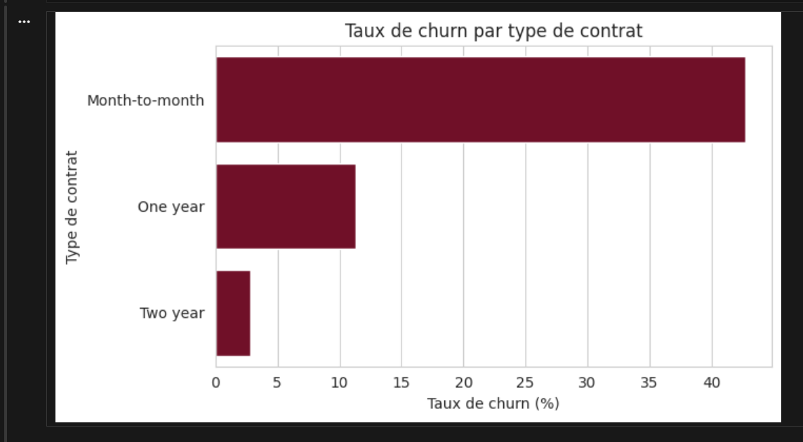
Factor 1 — Contract Type
88.6%
of ALL churned customers come from month-to-month contracts
Interpretation
Month-to-month contracts churn at 42.7% vs. 11.3% (one-year) and 2.8% (two-year). The likely root cause is weak contractual commitment: without a fixed-term agreement customers face no barrier to leaving at any time. This is the single strongest churn driver identified in the analysis.

Slide 5
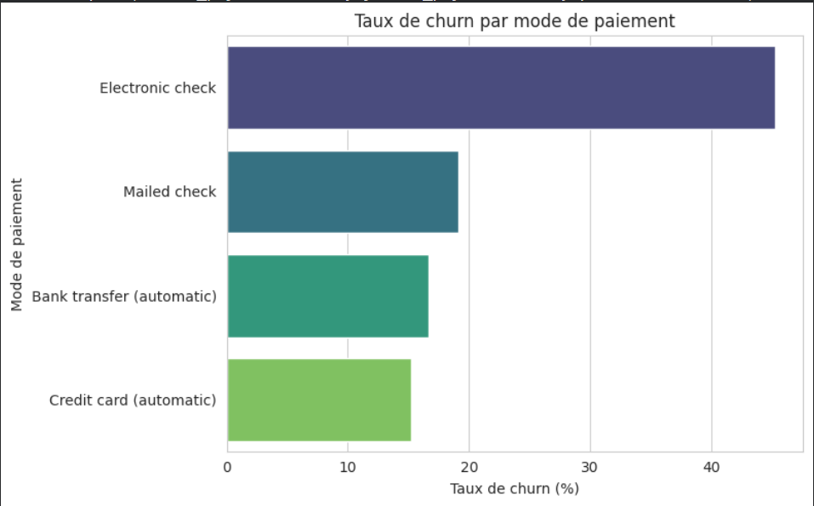
Factor 2 — Payment Method
45.3%
churn rate for customers paying by electronic check
Interpretation
Electronic check customers churn roughly 3x more than those on automatic payment methods. Manual recurring payments create friction and repeated opportunities to cancel while automatic billing keeps customers subscribed passively, by default.

Slide 6
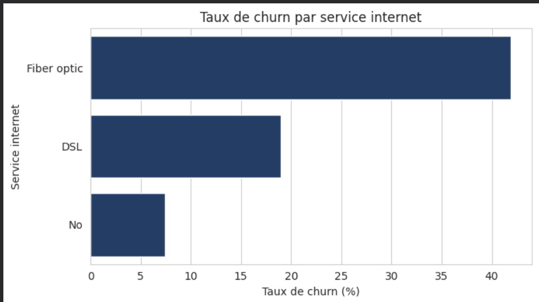
Factor 3 — Internet Service
41.9%
churn rate on Fiber optic — the highest of any service tier
Interpretation
Churn rises with service tier: 7.4% (no internet) to 18.9% (DSL) to 41.9% (Fiber optic). This counter-intuitive pattern points to value perception rather than loyalty — Fiber optic, the priciest tier likely faces stronger price sensitivity and higher expectations.

Slide 7
Risk Factors Compound
Customers combining all three risk factors form a small but critical high-risk profile
18.6%
60.4%
2.3x
of customers combine Month-to-month + Electronic check + Fiber optic
churn rate within this combined risk profile
higher than the overall company churn rate (26.5%)
This is the most actionable finding in the analysis: it defines a precise, targetable customer profile rather than a vague, company-wide risk.

Slide 8
Key Business Insights
1
Contract type is the dominant churn driver (88.6% of churners are month-to-month).
2
Payment method is a strong secondary factor (57.3% of churners pay by electronic check).
3
Fiber optic is both the largest (44%) and most fragile segment (41.9% churn).
4
Risk factors compound — the combined high-risk profile churns at 60.4%.
5
Churn concentrates early: median tenure of 10 months for churners vs. 38 for loyal customers.

Slide 9
Recommendations
1
2
Convert contracts
Automate payments
Incentivize month-to-month customers to switch to 1- or 2-year contracts, prioritizing the first 12 months.
Offer a discount or incentive for customers moving from electronic check to automatic payment.
3
4
Investigate Fiber optic
Target the high-risk profile
Run a targeted satisfaction study to identify price, quality, or competitive drivers of churn.
Build a bundled retention offer for customers combining all three risk factors.
5
Strengthen onboarding
Launch a structured early-tenure program: welcome offers, check-ins, satisfaction surveys.

Slide 10
Conclusion
Churn at Telecom is not random. It concentrates around contract flexibility, payment method and Fiber optic service. These factors compound into a precise, targetable high-risk profile. Prioritizing contract conversion, payment automation and early-tenure retention offers the clearest path to a measurable sustainable reduction in churn.
AnalystLab Africa Consulting — Week 1

